Slide 1

NOV – Capital Investment Plan 2023 Team 8

Slide 2

Introduction

Slide 3

Problem Statement
Determine the best division within NOV Inc. to invest 2023 capital by analyzing the return on capital for each division and considering various factors such as cost, revenue, assets, liabilities, and trends over time.

Slide 4
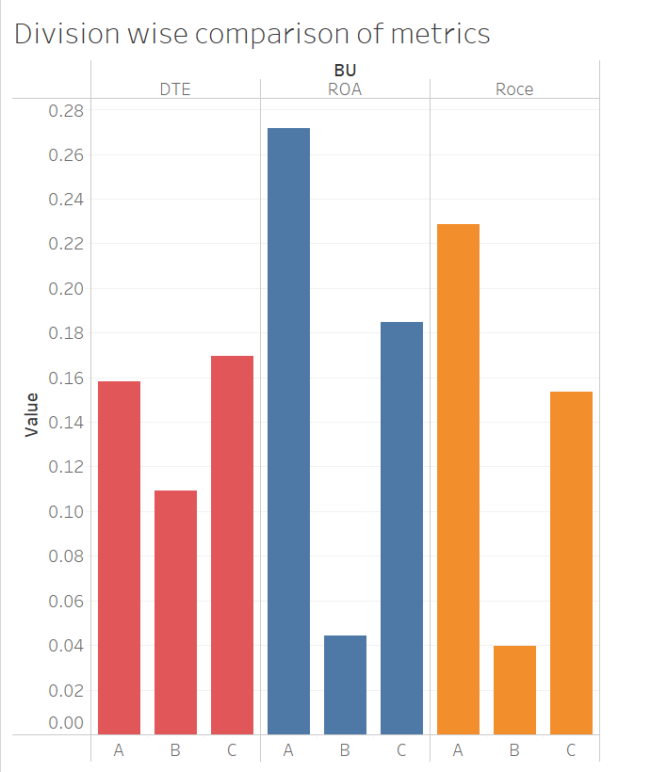
Comparison of metrics

Slide 5
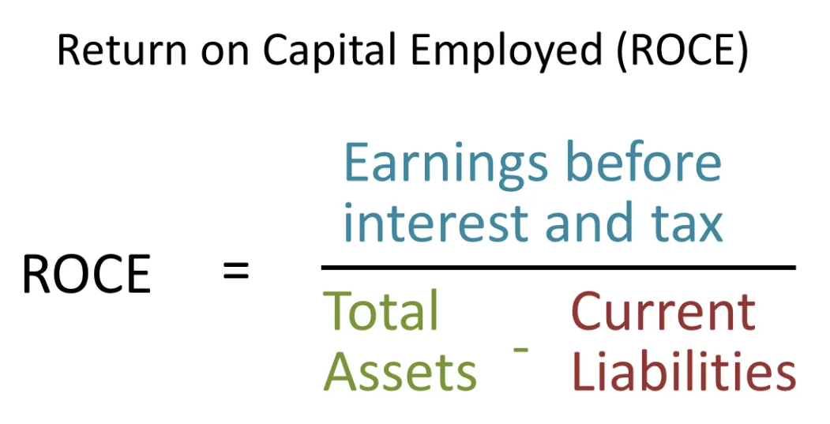
Key data and Statistics

Slide 6
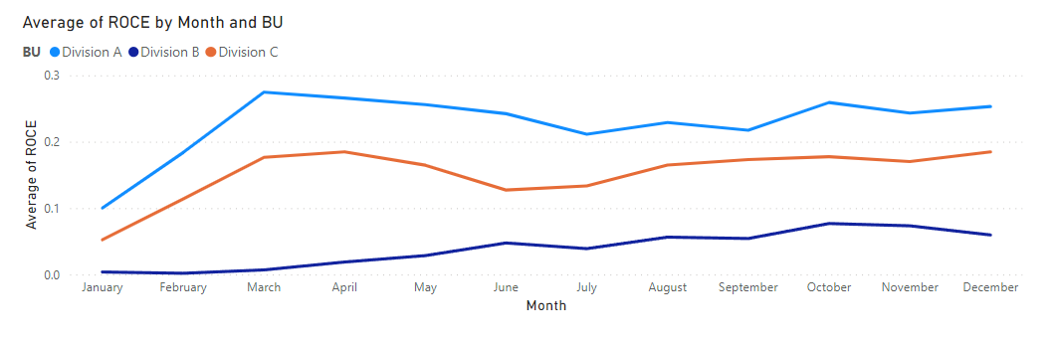
Trend Lines

Slide 7
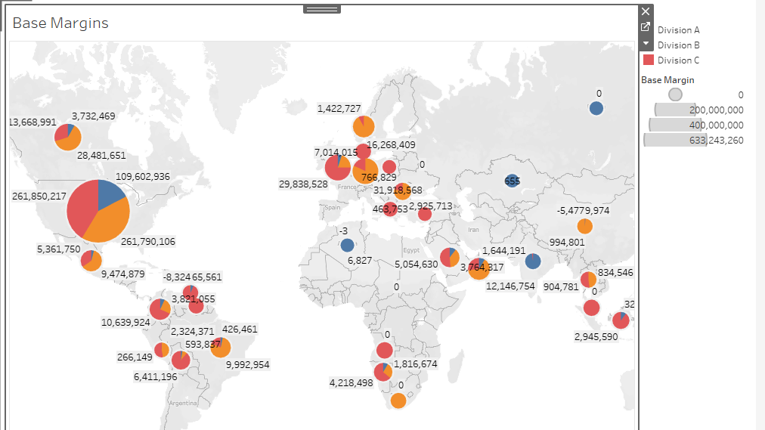

Slide 8
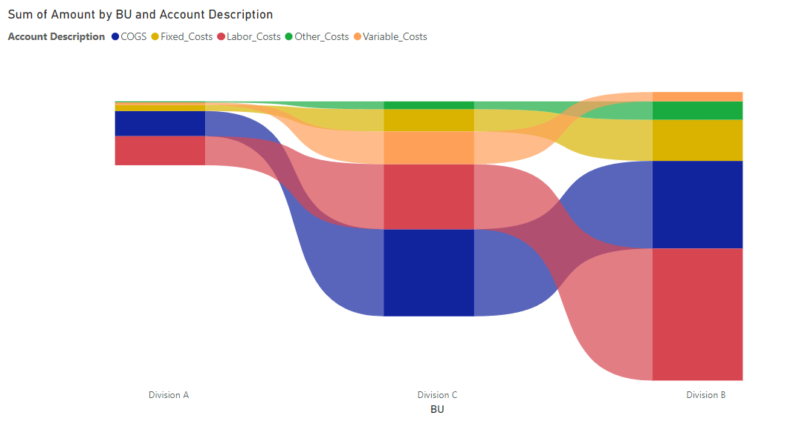

Slide 9
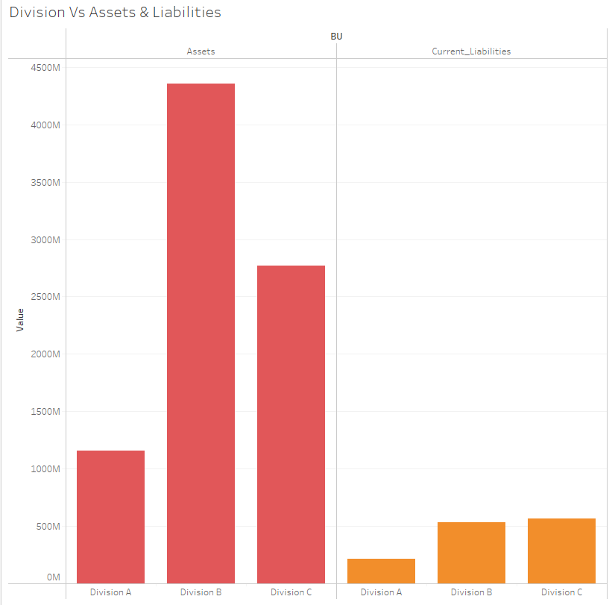
Assets & Liabilities

Slide 10
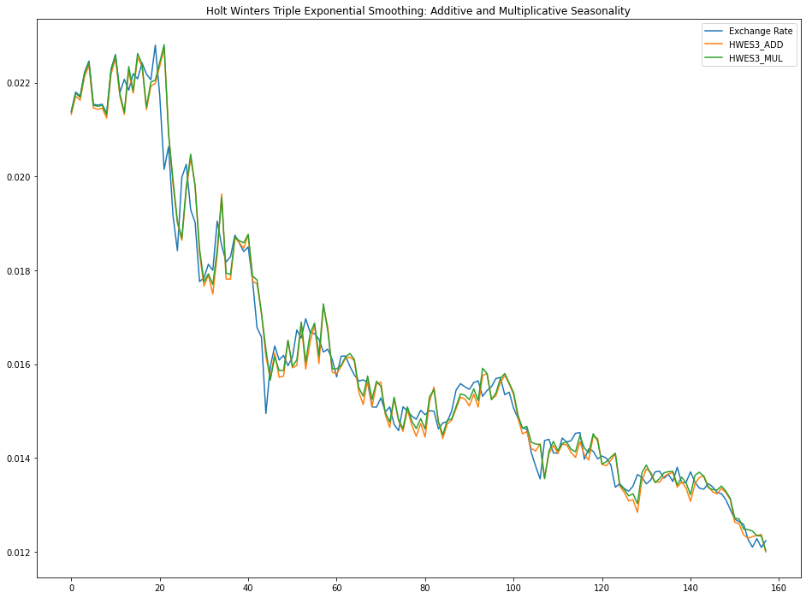
Predictive model for exchange rates

Slide 11
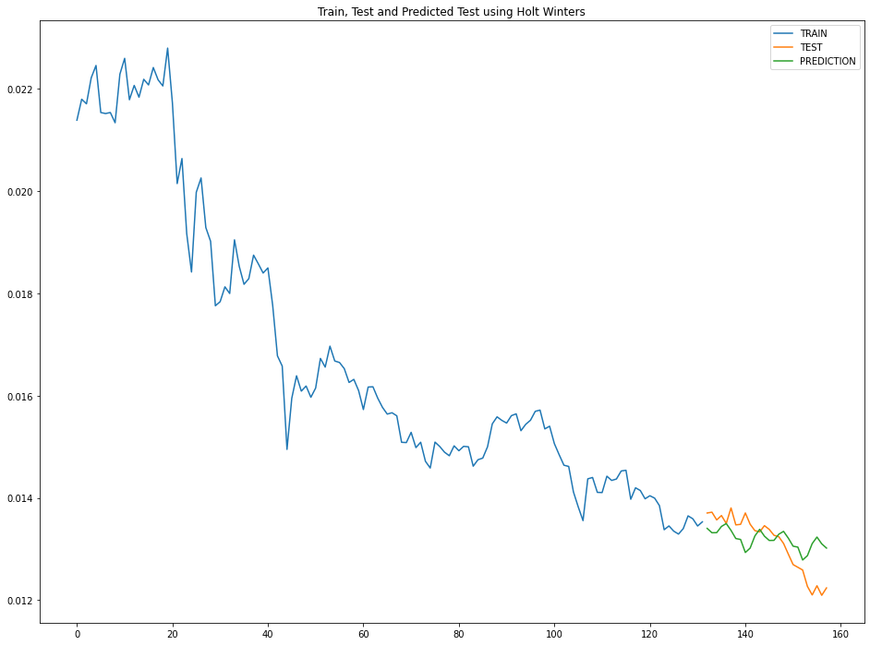
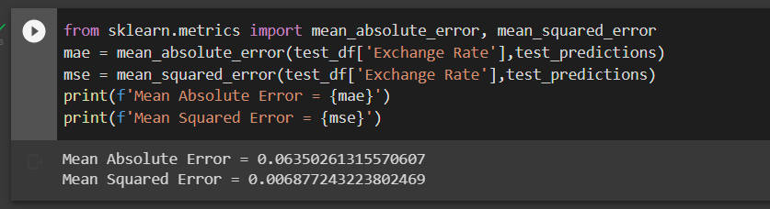

Slide 12
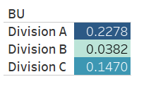
Prediction for 2023

